Slide 1
Electronic Instrumentation Section-1, Ppt-9

Slide 2
Distortion Analyzers

Slide 3
What is harmonics?
Harmonic distortion is the distortion in our signal that is produced by the additional frequencies generated in the signal.
Harmonic distortion occurs in sound waves
It also occurs in electrical signals, that is, when a current is passing through a circuit, it can induce vibrations in the circuit .
Hence these vibrations can cause distortion in our original signal. This distortion in current can lead to many problems like voltage fluctuation etc.

Slide 4
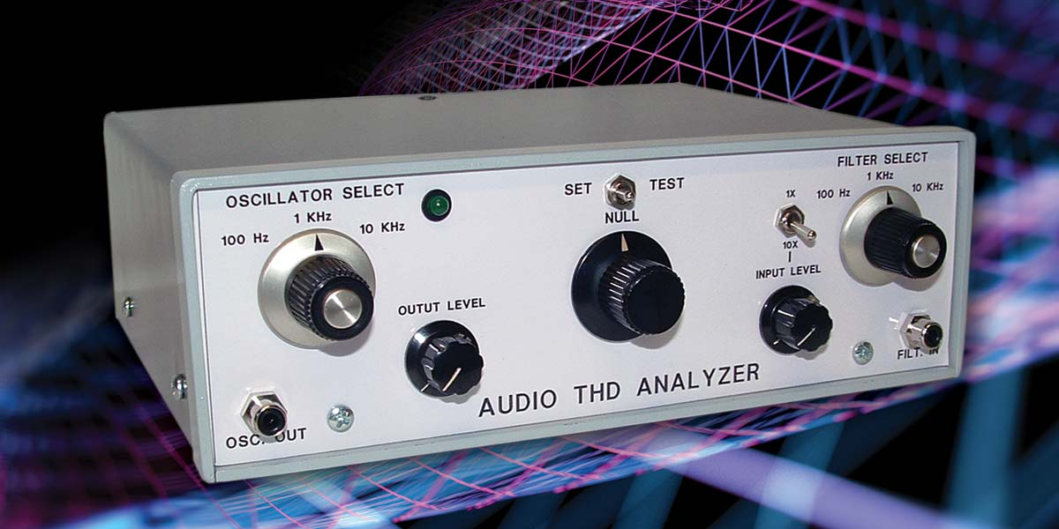
DISTORTION ANALYZERS
Inherent nonlinear characteristics of active devices such as bipolar or field-effect transistors or by passive circuit components.
The amount of distortion can be measured with a distortion analyzer.

Slide 5
Total Harmonic distortion
A total harmonic distortion analyzer calculates the total harmonic content of a sine wave with some distortion, expressed as total harmonic distortion (THD).
The total harmonic distortion (THD). which is frequently expressed as a percentage, is defined as the ratio of the rms value of all the harmonics to the rms value of the fundamental

Slide 6
When an amplifier is not operating in a linear fashion, the output signal will be distorted. Distortion caused by nonlinear operation is called amplitude distortion or harmonic distortion.
It can be shown mathematically that an amplitude-distorted sine wave is made up of pure sine-wave components including the fundamental frequency f of the input signal and harmonic multiples of the fundamental frequency, 2f, 3f, 4f . . . , and so on.

Slide 7
DISTORTION ANALYZERS
On the basis of the assumption that any distortion caused by the components within the analyzer itself or by the oscillator signal are small enough to be neglected. Eq. 2 can be expressed as
where
THD = the total harmonic distortion
E_{f} = the amplitude of the fundamental frequency including the harmonics
E₂E₃E_{n} = the amplitude of the individual harmonics
THD = E(harmonics) fundamental

Slide 8
DISTORTION ANALYZERS
EXAMPLE 1:
Compute the total harmonic distortion of a signal that contains a fundamen­tal signal with an rms value of 10 V, a second harmonic with an rms value of 3 V, a third harmonic with an rms value of 1.5 V, and a fourth harmonic with an rms value of 0.6 V.

Slide 9
DISTORTION ANALYZERS
SOLUTION:
Using Eq. 3, we compute the total harmonic distortion as

Slide 10
Types of distortion analyzers
There are several types of distortion analyzers:
Fundamental suppression
Heterodyne type
Tuned circuit
Spectrum analyzer

Slide 11
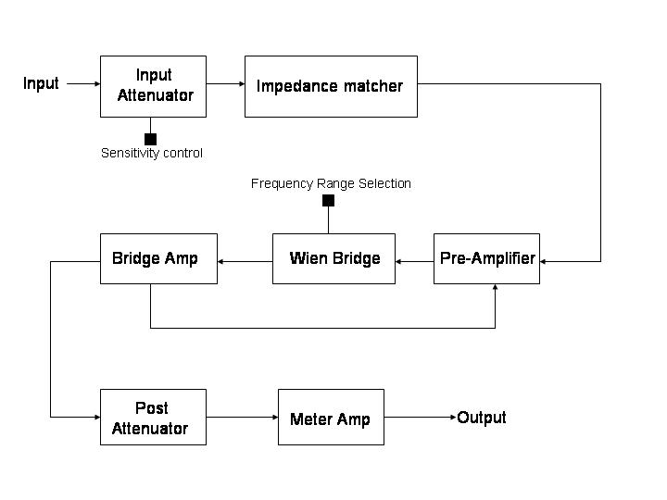
Fundamental Suppression Distortion Analyzer

Slide 12
Principles of operation
This type of THD analyzer filters out the fundamental frequency of a signal with a notch filter, leaving only distortion products plus noise; the ratio of this remnant to the signal amplitude is the THD.
A fundamental suppression analyzer consists of three main sections:
input section with impedance matcher,
a notch filter and amplifier section,
an output metering circuit. Negative feedback from the bridge amplifier to the pre-amp section may be applied to enable the rejection circuit to work more accurately.

Slide 13
Working
The input is impedance-matched with the rejection circuit with the help of an attenuator and an impedance matcher. This signal is then pre-amplified to a desired level.
The following section consists of a Wien bridge notch filter tuned to reject the fundamental frequency and balanced for minimum output by adjusting the bridge controls. The output, which is the remaining signal after the fundamental has been suppressed, is amplified to a measurable level.
A feedback loop from the bridge amplifier output to the pre-amp input helps to eliminate any remaining contribution from the fundamental frequency. The output from these blocks is measured, typically using an instrumentation amplifier driving an analog or digital meter. The voltage at the meter is due to the harmonic distortion products plus noise.

Slide 14
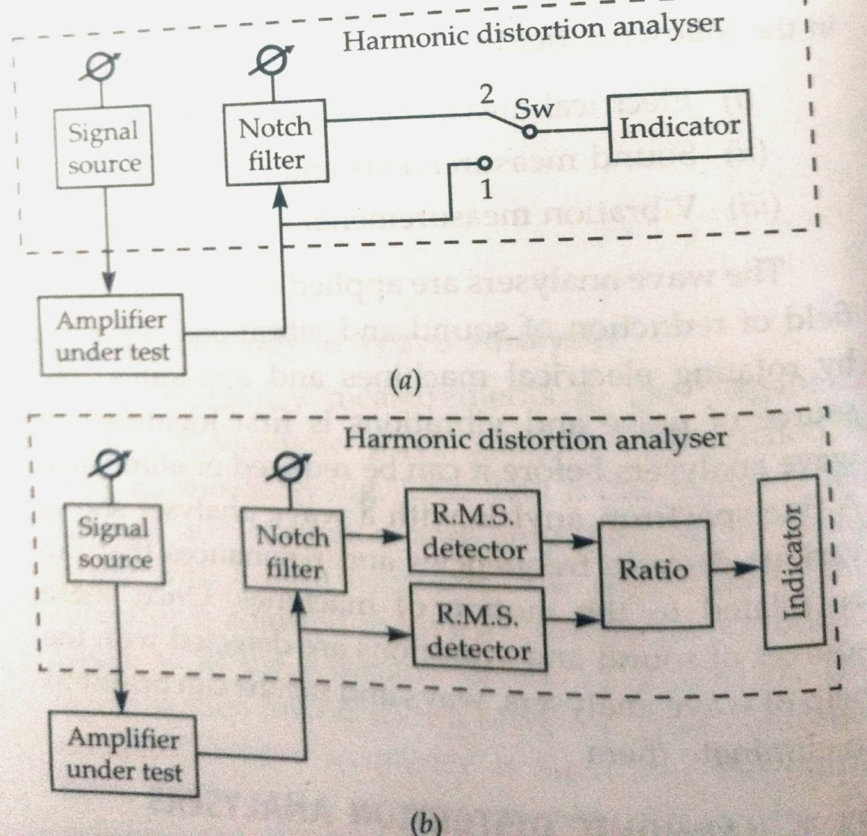
Fig.2a and Fig2b

Slide 15
Harmonic Distortion analyzers
The switch SW is first placed in position 1 and the total content of fundamental and harmonics is measured.
Then the switch is moved to position 2 to measure just the harmonics . The value of THD is
THD= EH/ET*100

Slide 16
Harmonic Distortion analyzers
Fig.2b shows an alternative arrangement, where the values of Et and Eh are read simultaneously and their ratio calculated and displayed as THD on the indicator.
For good accuracy the notch filter must have excellent rejection and high pass characteristics

Slide 17
Applications
Distortion meters are being widely used now a days especially in music industry.
To make the sound more pleasing and musical, many frequencies are eliminated and some are enhanced as well. For eliminating the unwanted frequencies we use a distortion meter.
Many advance electrical machines use distortion meters to compensate for the current distortions so that the expensive appliance can be saved from damage due to these distortions.

Slide 18
THD+N is a scale used to expressing _______ of an audio amplifier. a) Gain b) Sound quality c) Amplification factor d) Distortion

Slide 19
THD is a measure of ____________ a) Amount of harmonic content present in signal b) Amount of output power c) Total amount of distortion d) Total amount of amplitude distortion

Slide 20
The ratio of the RMS amplitude of the higher order harmonic frequencies to the RMS amplitude of the fundamental frequency is commonly called __________ a) Total harmonic power b) Total amplitude distortion c) Total frequency distortion d) Total harmonic distortion

Slide 21
Intermodulation distortion is caused by __________ a) Presence of harmonic components in signal b) Non- linearity of biasing circuit c) Non-linearity of amplifier d) High frequency signal

Slide 22
The ratio of the RMS value of additional frequency components in output to the RMS value of the original output of the amplifier is called __________ a) Intermodulation distortion b) Total amplitude distortion c) Total frequency distortion d) Total harmonic distortion View Answer

Slide 23
Second order harmonic distortion is __________ a) Amount of second harmonics and first harmonics in signal b) Amount of second harmonics and fourth harmonics in signal c) Amount of second harmonics present in signal d) RMS value of all even harmonics in signal

Slide 24
If D1, D2, D3, D4 are the distortion produced by second, third, fourth, fifth respectively (others are insignificant). Then total harmonic distortion is __________ a) √(D1²+D2²+D3²+D4²) b) √(D1²+D3²) c) √(D2²+D4²) d) √(D1²+D2²)

